Slide 1
INVESTMENT ANALYSIS
A Detailed Project Report
Gourav Rathi
Data Scientist Intern
iNeuron.AI

Slide 2
PROJECT DETAILS
Project Title | Investment Analysis
Technology | Business Intelligence
Domain | Finance
Project Difficulty level | Intermediate
Programming Language Used | Python
Tools Used | Jupyter Notebook, MS-Excel, Tableau

Slide 3
Objective :
The goal of this project is to find the equilibrium investment from the given dataset.

Slide 4
Problem Statement
Investment is a game of understanding historic data of investment objects under different events but it is still a game of chances to minimize the risk we apply analytics to find the equilibrium investment.
To understand the Foreign direct investment in India for the last 17 years from 2000-01 to 2016-17. This dataset contains sector and financial year-wise data of FDI in India
Sector-wise investment analysis
Year-wise investment analysis
Find key metrics and factors and show the meaningful relationships between attributes.

Slide 5
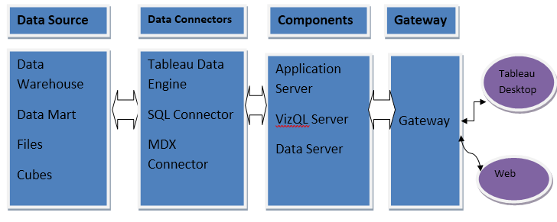
Architecture

Slide 6
Why parameters are important
Sector: In the 1st column, Sector names are mentioned. There are total different 63 sectors, some of them are AGRICULTURAL MACHINERY, AGRICULTURE SERVICES, AUTOMOBILE INDUSTRY, COMPUTER SOFTWARE & HARDWARE etc.
Year wise – Except 1st column, There are different 17 columns and in the columns years are mentioned from 2000-01 to 2016-17. In these column, Investment are mentioned.

Slide 7
Totals Sectors

Slide 8
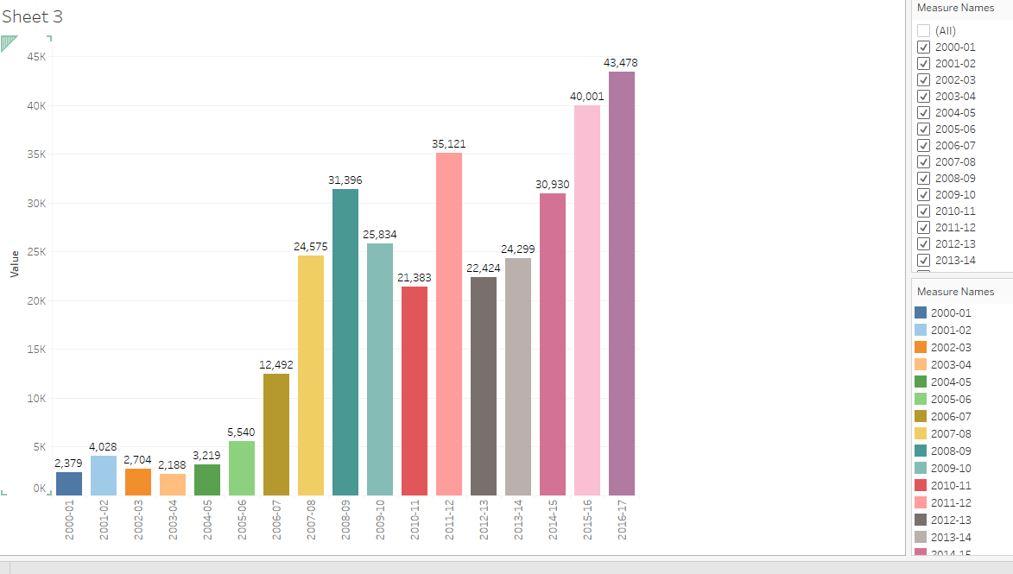
Total Investment Year Wise

Slide 9
Other Observations
Maximum investment is done in SERVICES SECTOR in 2016-17 whereas minimum investment is done in COIR.
It is also observed in 2000-01, There are 23 sectors in which no investment is done which is also maximum of no investment in any year.
Out of 63 sectors, In 36 sectors average investment is under 100.
Market Recession in 2008-09 made big losses for the Investors which was covered by 2011-12.
It is also seen that Service Sector was at the highest in all the Years even when the whole sectors were impacted due to crash .

Slide 10
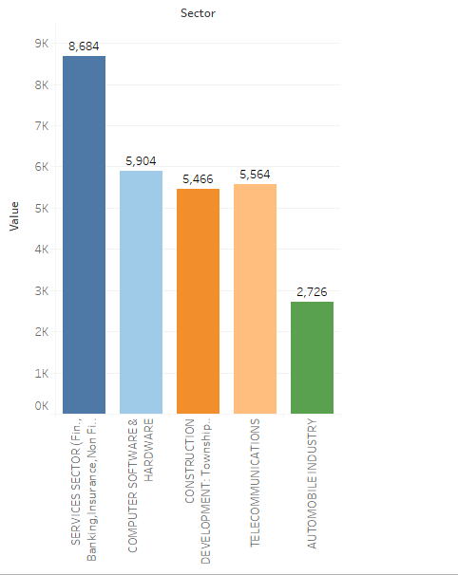
Top 5 Sector Investment Wise

Slide 11
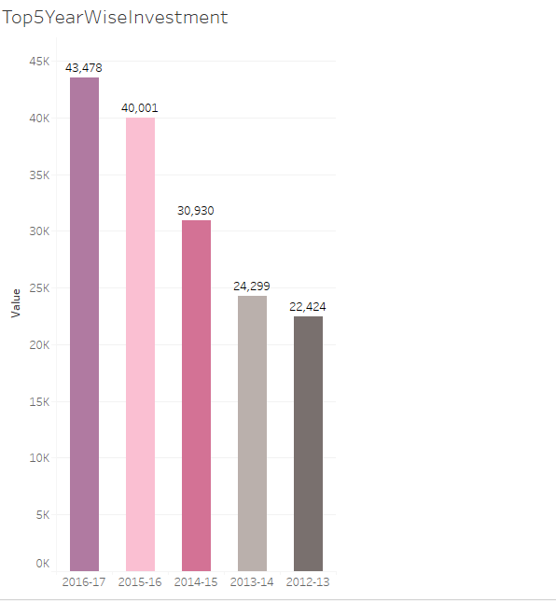
Top 5 Investment in term of years

Slide 12
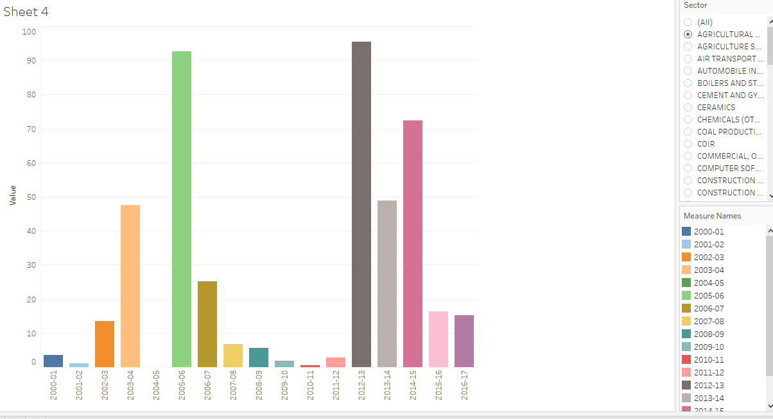
Total Investment In a Sector YearWise

Slide 13
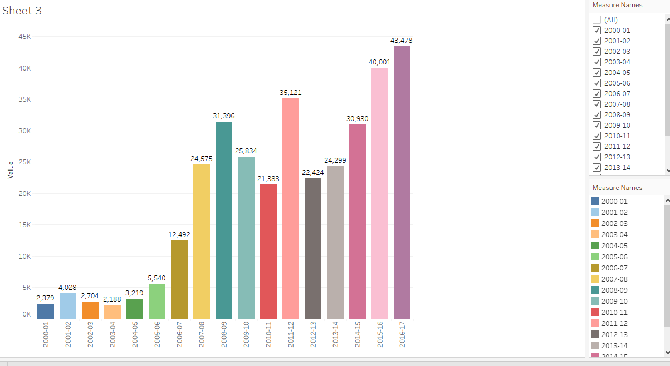
Year Wise Investment

Slide 14
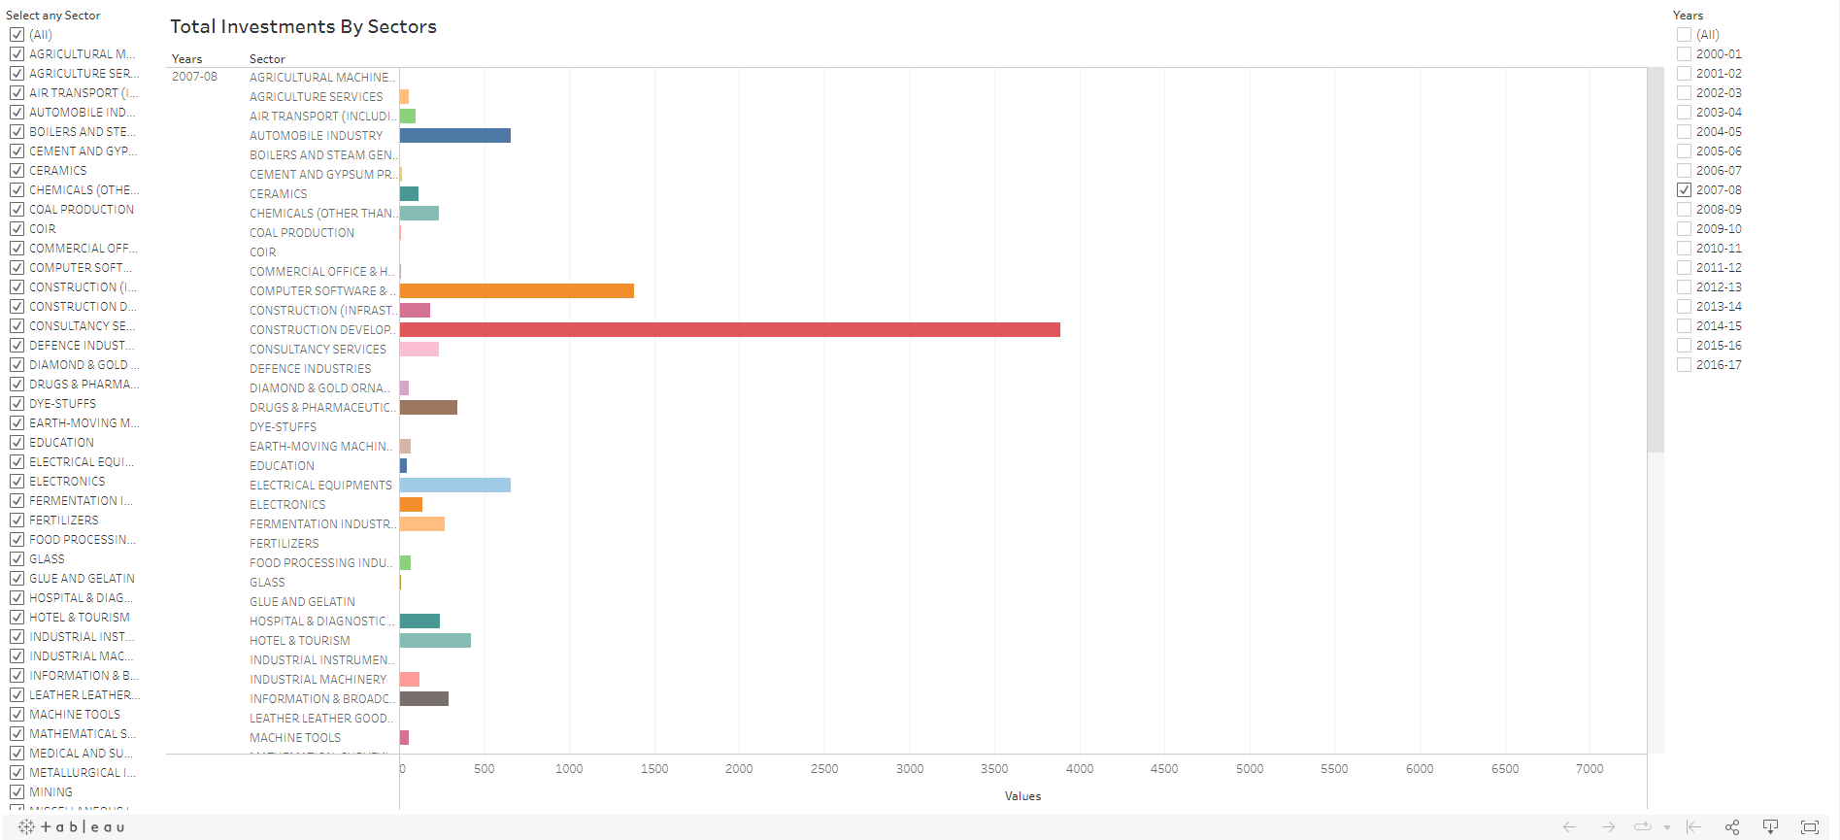
Sector Wise Analysis

Slide 15
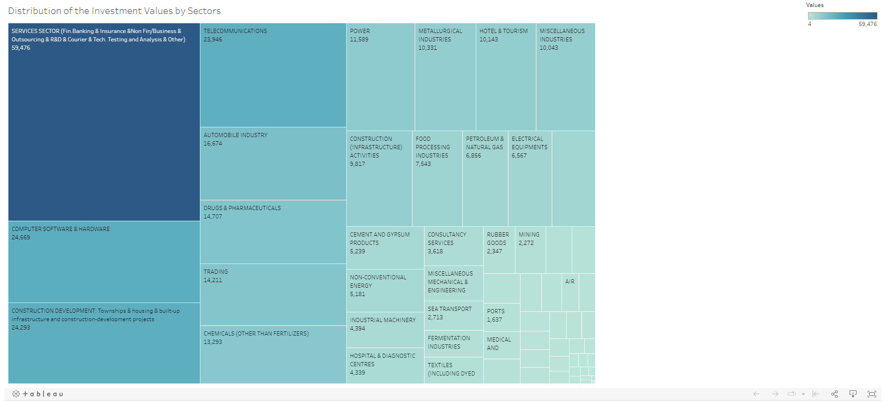
Distribution of Investments Values by Sectos

Slide 16
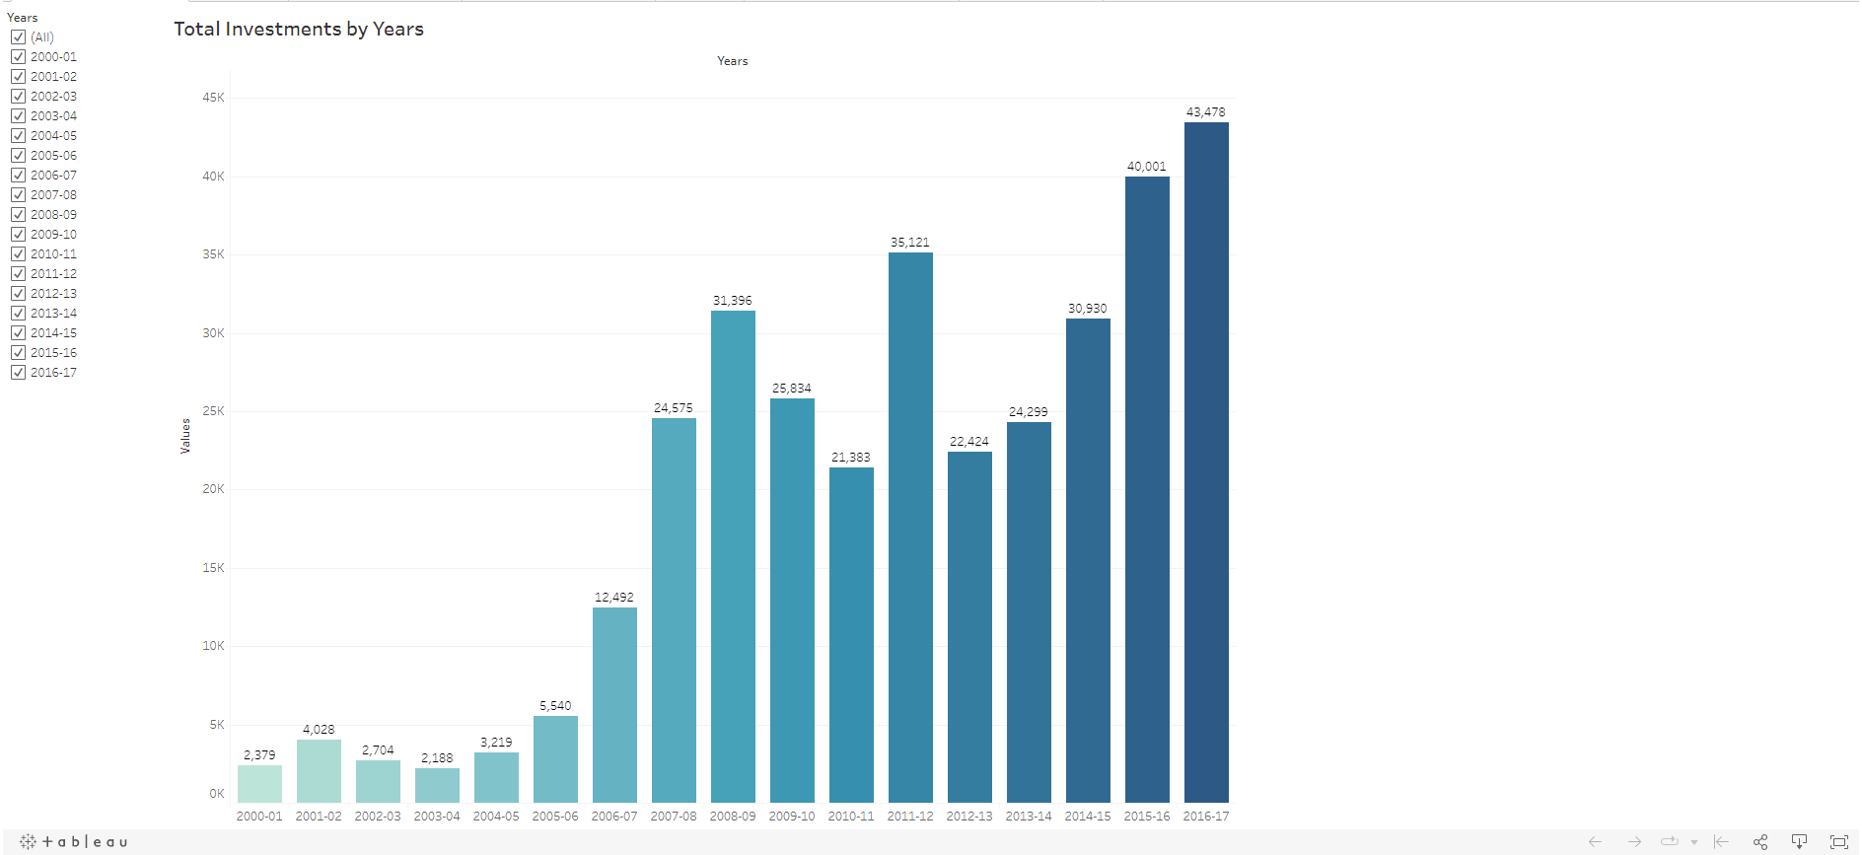
Year Wise Investment Analysis

Slide 17
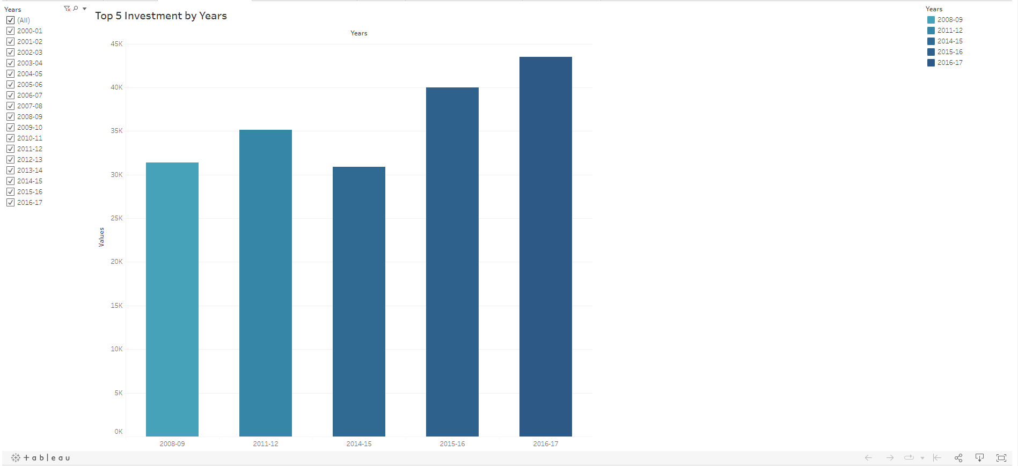
s
Top 5 Investments by Years

Slide 18
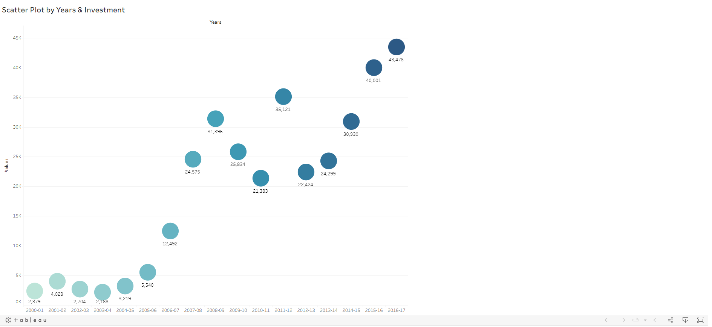
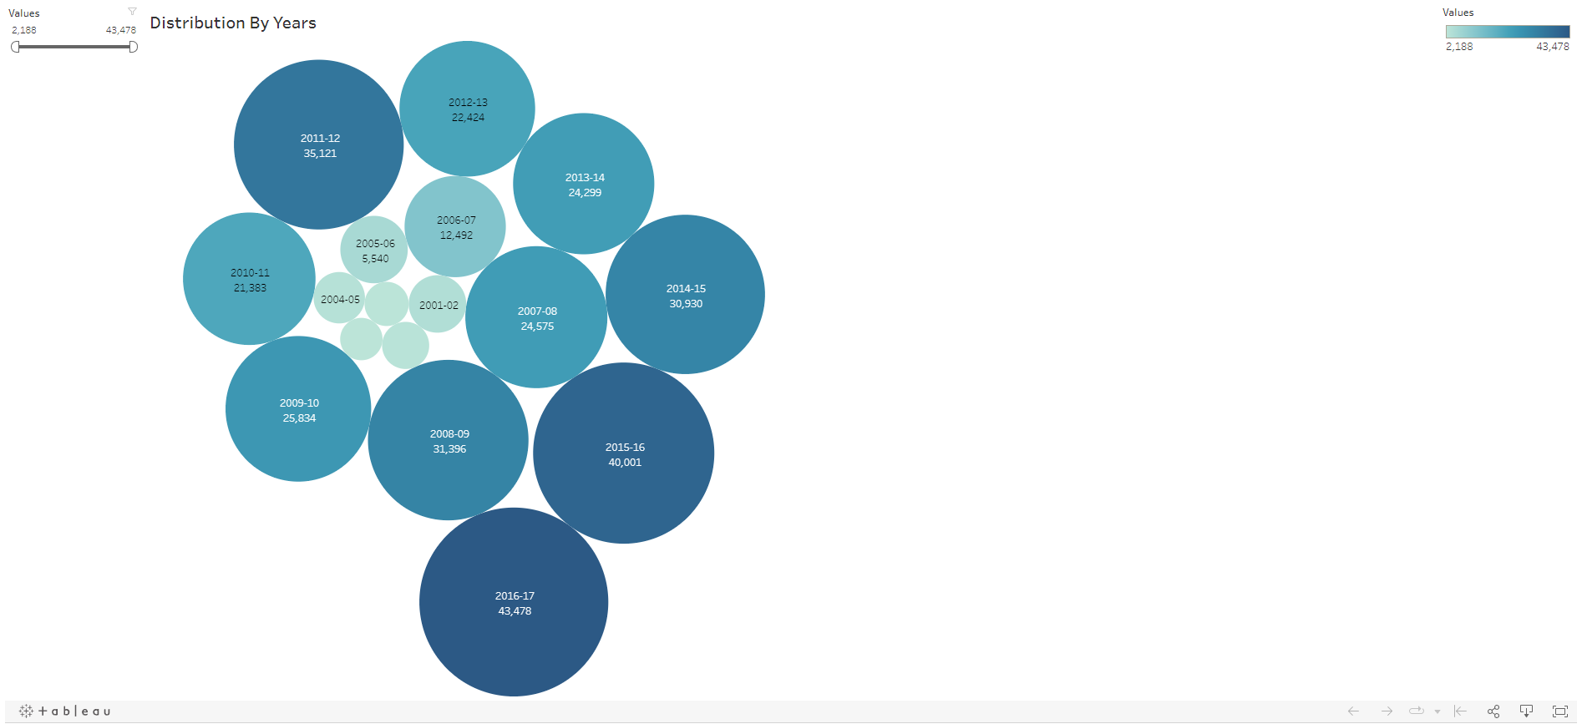
Scatter Plot by Years & Investment
Bubble chart representing Distribution by Years

Slide 19
THANK YOU

